Slide 1
A physical interpretation for the use of moving average functions to construct valid variograms families in statistical models of stream networks

Slide 2
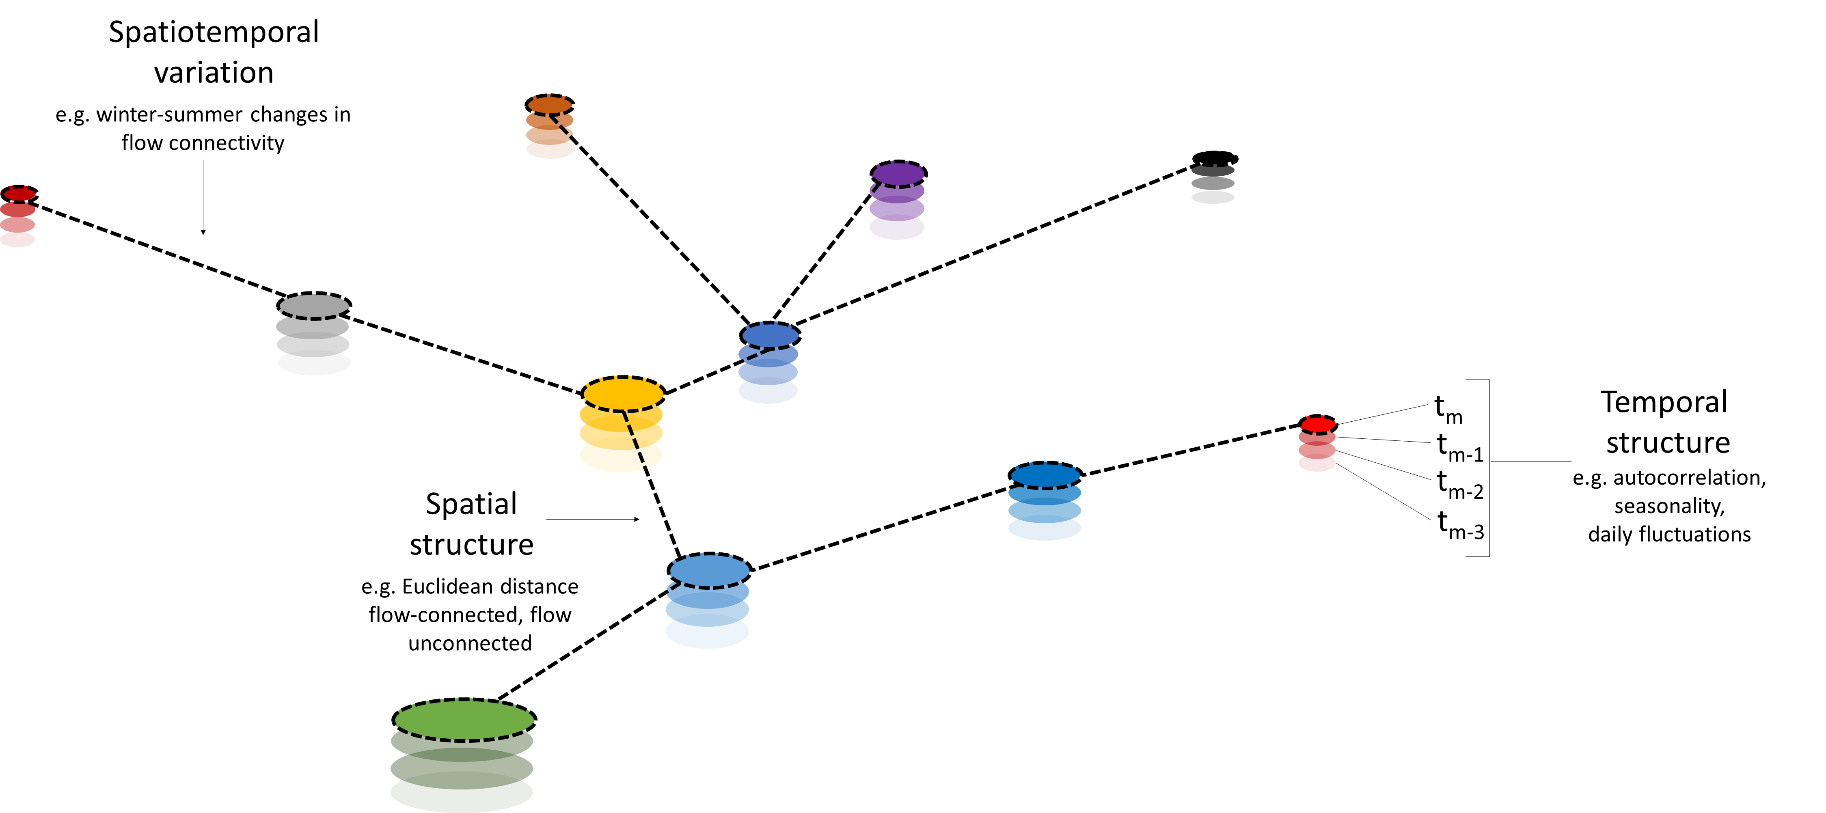

Slide 3
Ver Hoef et al., 2014. SSN: An R Package for Spatial Statistical Modeling on Stream Networks
In this paper they implement the models into an R package
Ver Hoef et al., 2010. A Moving Average Approach for Spatial Statistical Models of Stream Networks
In this paper they generalize the moving average approach to downstream/upstream flows and fish migration
Ver Hoef et al., 2006. Spatial Statistical Models that Use Flow and Stream Distance
In this paper they introduce the models that use moving average approaches and apply it to passive solutes. This is a geostatistical approach
in contrast to Monestiez et al., 2005.
Cressie et al., 2006. Spatial Prediction on a River Network
They formalize the moving average approach by using stochastic calculus inspired in Brownian motion.
Monestiez et al., 2005. Geostatistical Modelling of Spatial Processes on Directed Trees: Application to Fluvisol Extent.
They study the underlying probabilistic model of a given topology (labeled as Acyclic Directed Graphs)

Slide 4
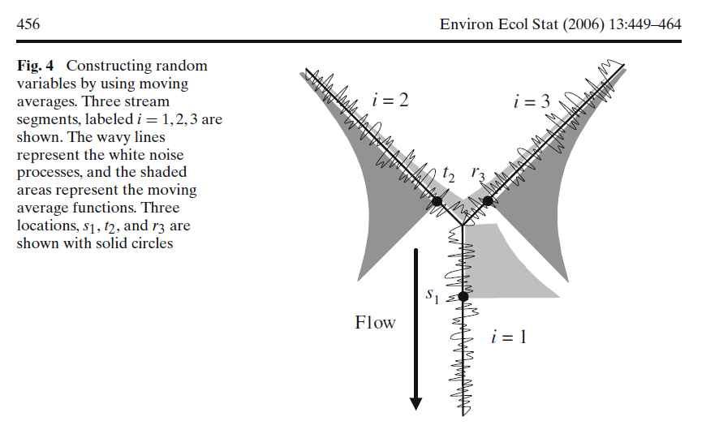
x₁
x₂
Moving average
Brownian motion

Slide 5
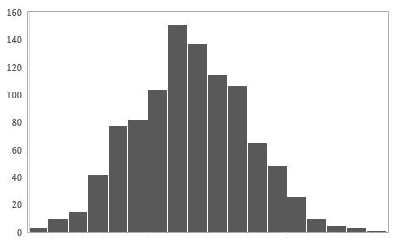
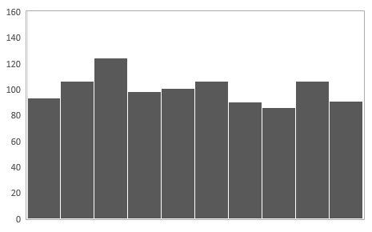
White Noise
Weighted Moving Average (order 3)
g(t) =g_{t}+ α*g_{t-1}+β *g_{t-2} +γ *g_{t-3}
g(t)
t
t
f[g(t)]
g(t)
g(t)

Slide 6
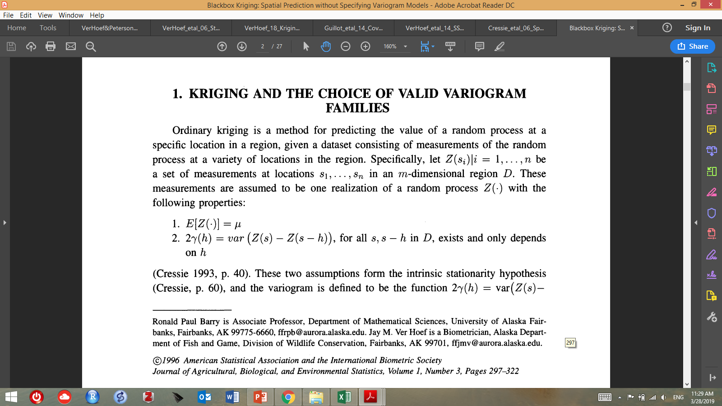
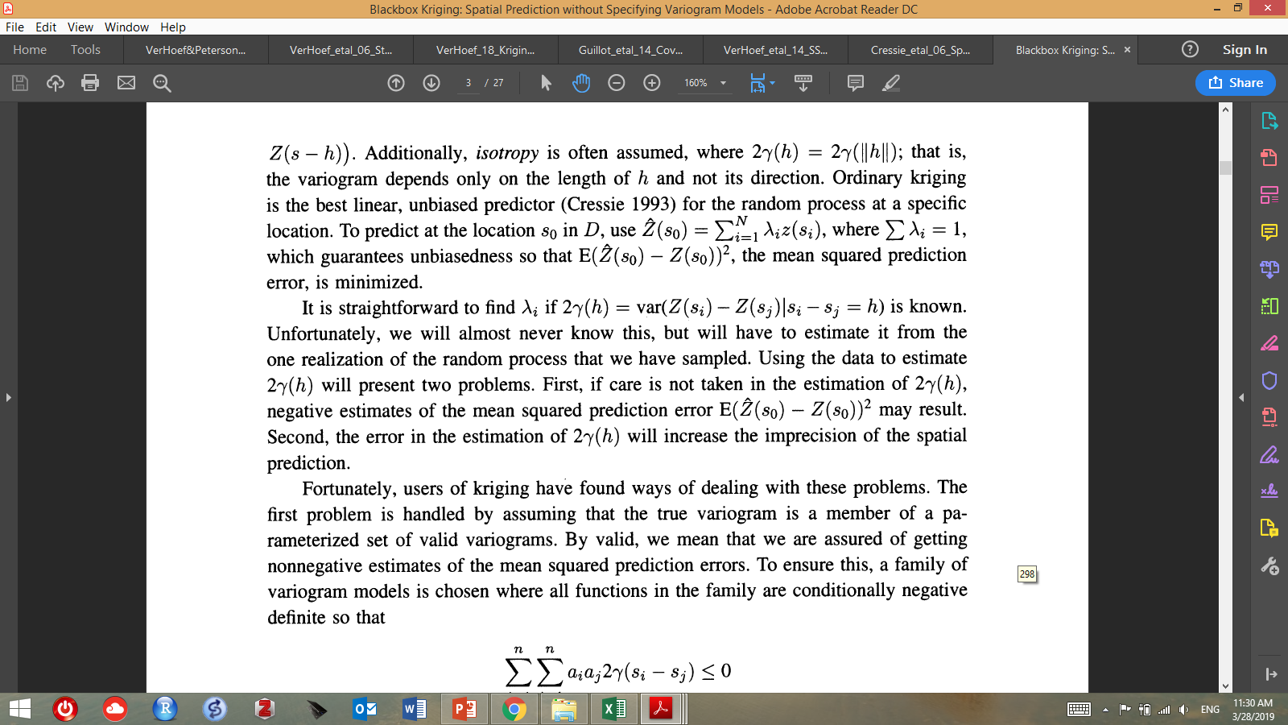
Barry & Ver Hoef. 1996. Black Box Kriging: Spatial Prediction Without Specifying Variogram Models

Slide 7
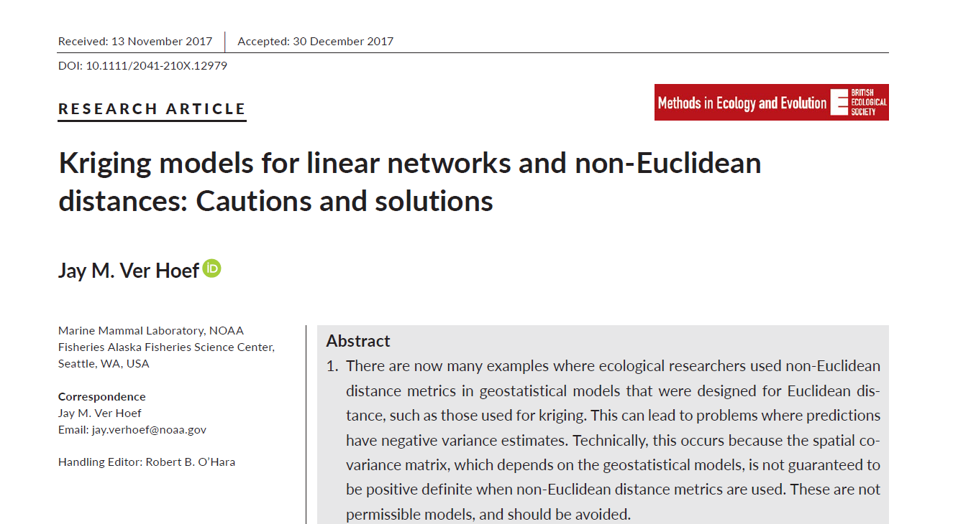

Slide 8
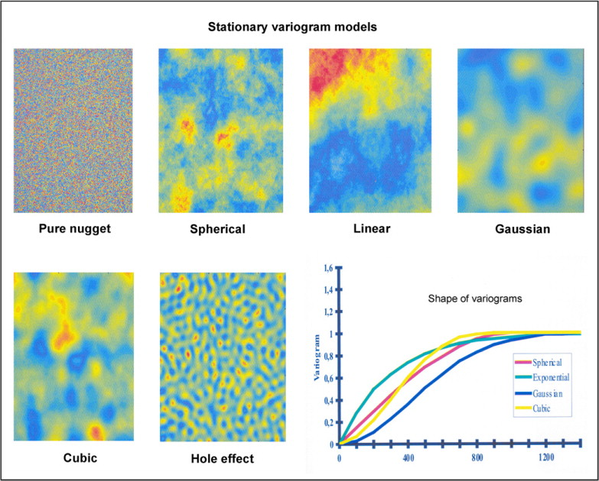

Slide 9
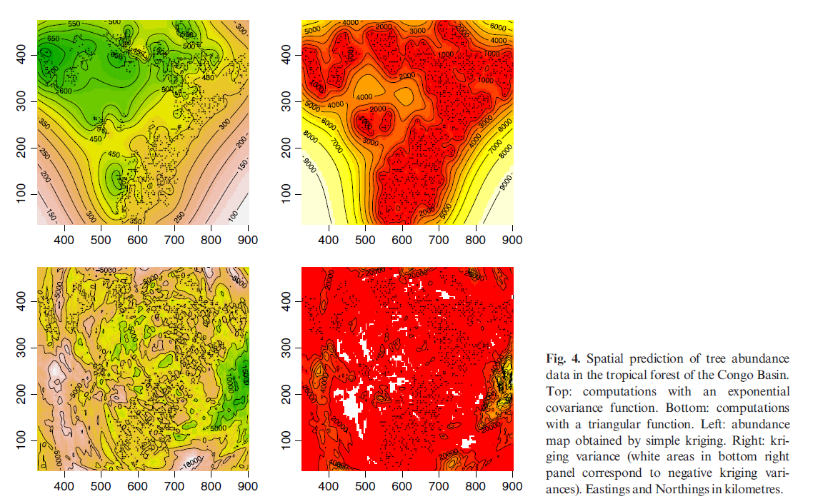
Abundance (Kriging)
Kriging variance
Exponential function
Triangular function (wrong function)

Slide 10
Measurements across space: collections of vectors of random variables
x₁
Distribution of the Random variable Z(x₁)
x₂
Z(x₁)
…………..
z₁
z₀(x₁)
Distribution of the Random variable Z(x₂)
…………..
Z(x₂)
Realizations of the
random process Z(x)
z₀(x₂)
z₂

Slide 11
Homogeneity hypothesis: the nature of the random process does not change across space
x
Distribution of the Random variable Z(x)
h
x+h
Z(x)
…………..
z_{x}
z₀(x)
Distribution of the Random variable Z(x+h)
…………..
Z(x+h)
Realizations of the
random process Z(x)
z₀(x+h)
Z_{(x+h)}

Slide 12
Intrinsic stationarity hypothesis: the nature of the random process does not change over time
x
Distribution of the Random variable Z(x)
h
x+h
Z(x)
……………..
z_{x}
z₀(x)
Distribution of the Random variable Z(x+h)
…………..
Z(x+h)
Realizations of the
random process Z(x)
z₀(x+h)
Z_{(x+h)}

Slide 13
Intrinsic stationarity hypothesis: the nature of the random process does not change over time
x
Moving average
Distribution of the Random variable Z(x)
h
x+h
Z(x)
……………..
z_{x}
Brownian motion
z₀(x)
Distribution of the Random variable Z(x+h)
…………..
Z(x+h)
Realizations of the
random process Z(x)
z₀(x+h)
Z_{(x+h)}

Slide 14
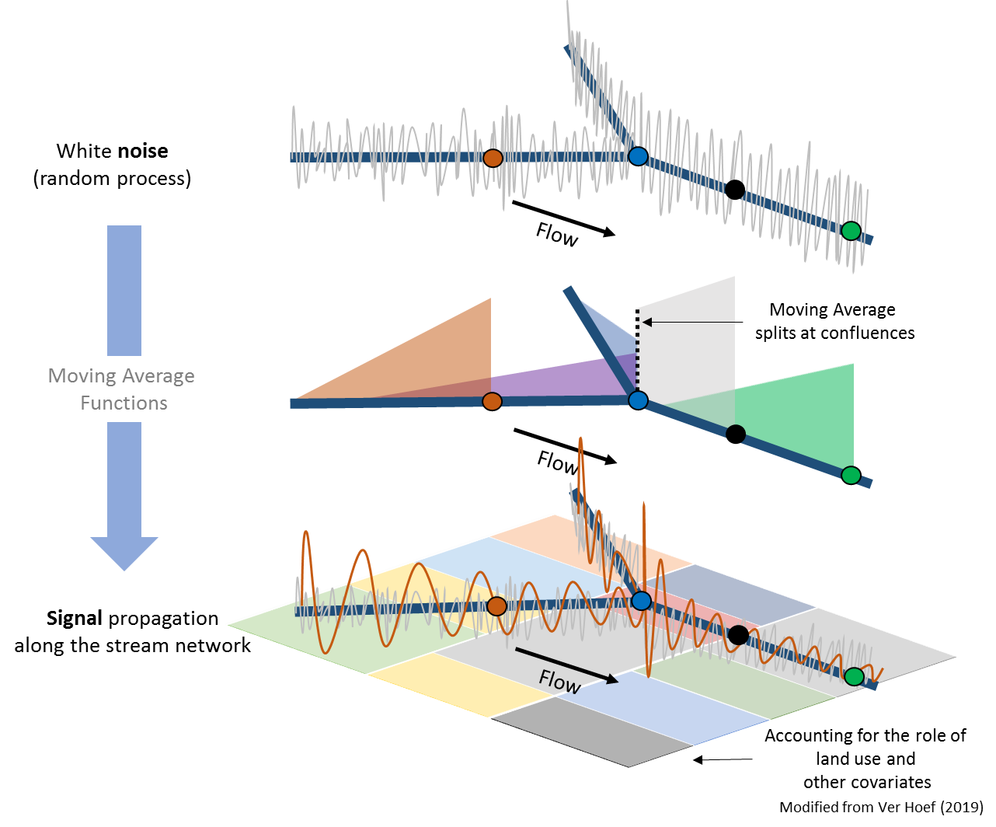
A Moving Average Approach for Signal Propagation along Stream Networks
This approach is inspired in time series models.
Although auto-regressive (AR) models
are more popular, Moving Average (MA) models
have interesting properties.
In an attempt to create multivariate spatial models
and filter white noise across space, JVH developed the
mathematical framework, but it was EP who came with
the idea of applying these models to stream networks.
When the moving average approach is extended to the
continuous domain, the distances between observations
approach zero (i.e. the MA becomes a white noise
process) and an integral is required to average these values
(instead of a sum), which gives you the solution as a
continuous random function.
Under weak stationarity assumptions the autocorrelation
and the semi-variograms are related and can be predicted from
different autocorrelation models (e.g. Tail Up, Tail Down).
Tail Up models (shown in the figure) produce contrasting
autocorrelation structures to those produced by Tail Down
Models. Furthermore, TU models require an additive
function which determines how much of the area under the
curve is assigned to each branch in the network as the join at
a confluence.

Slide 15
z
Measurements
Simulation
Krigging
Reality
x

Slide 16

A Moving Average Approach for Signal Propagation along Stream Networks
Modified from Ver Hoef (2019)

Slide 17
A Moving Average Approach for Signal Propagation along Stream Networks
Modified from Ver Hoef (2019)
Stream network
Land use, climate
Total variability
Noise

Slide 18
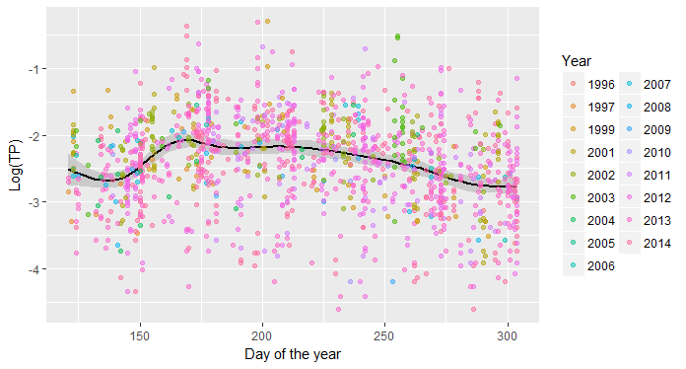
Seasonal variation has a strong influence on the dataset
(we account for seasonality with the terms SDT and CDT ?)
“Spring”
“Summer”
“Fall”

Slide 19
Variance components
General
Spring
Summer
Fall

Slide 20
Variance components
General
Spring
Summer
Fall

Slide 21
Variance components
General
Spring
Summer
Fall

Slide 22
Variance components
General
Spring
Summer
Fall

Slide 23
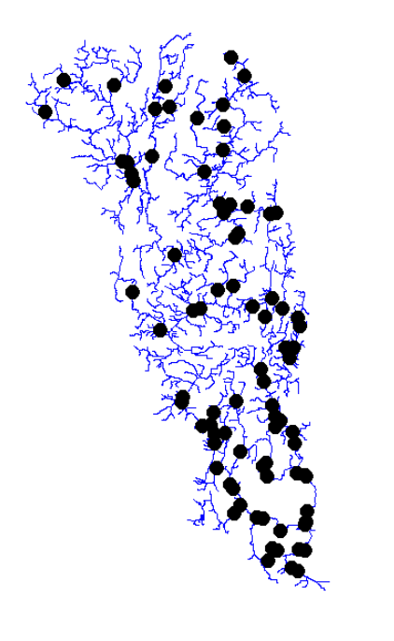
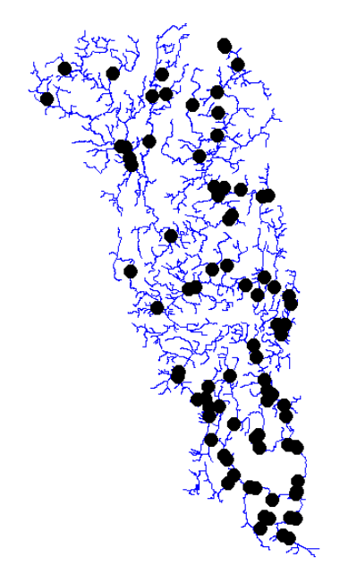
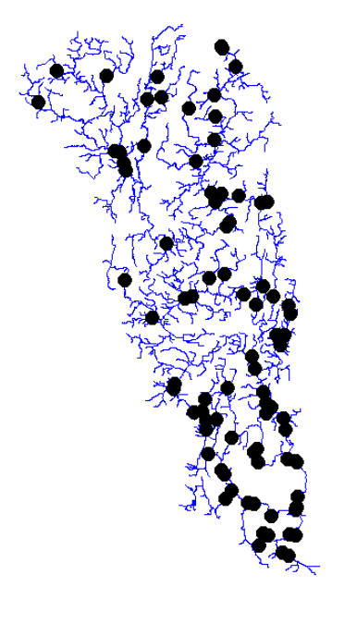
Spring
Summer
Fall

Slide 24
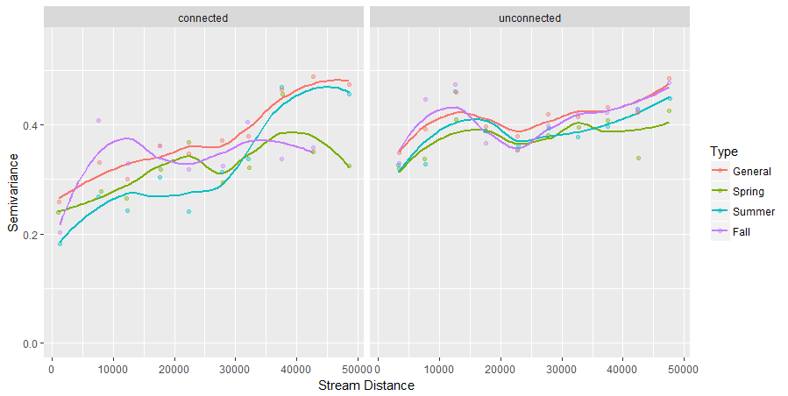
Seasonal variograms
(raw data)

Slide 25
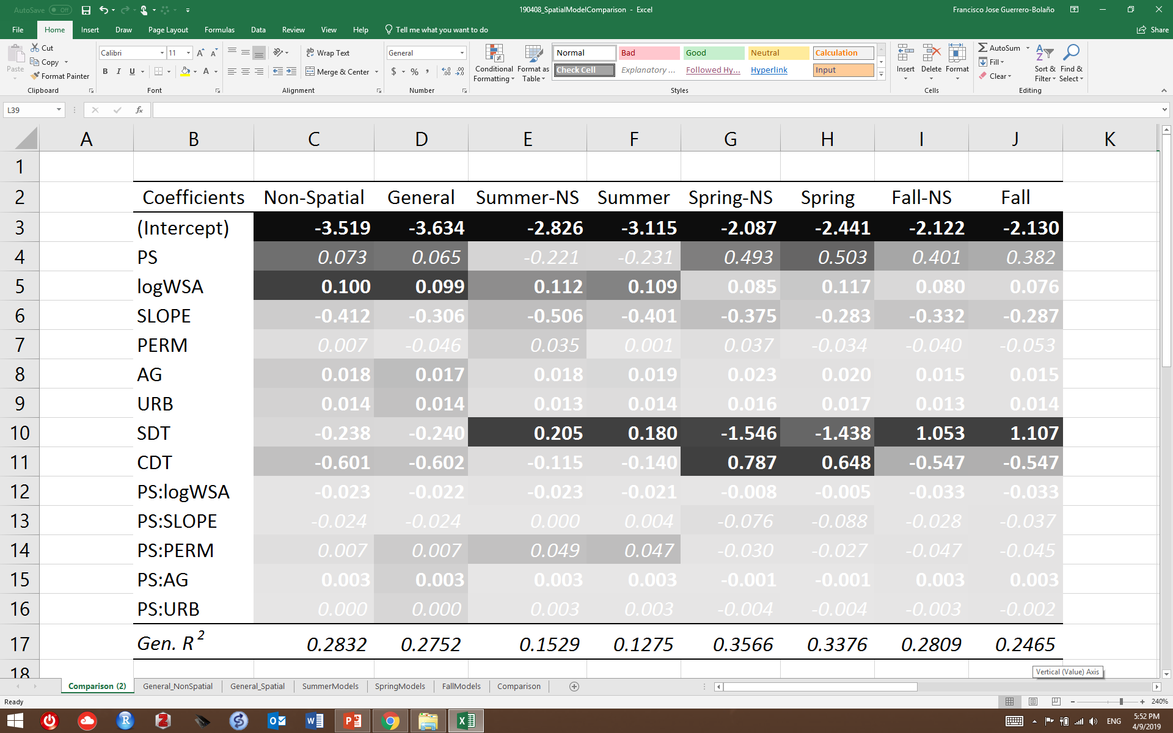
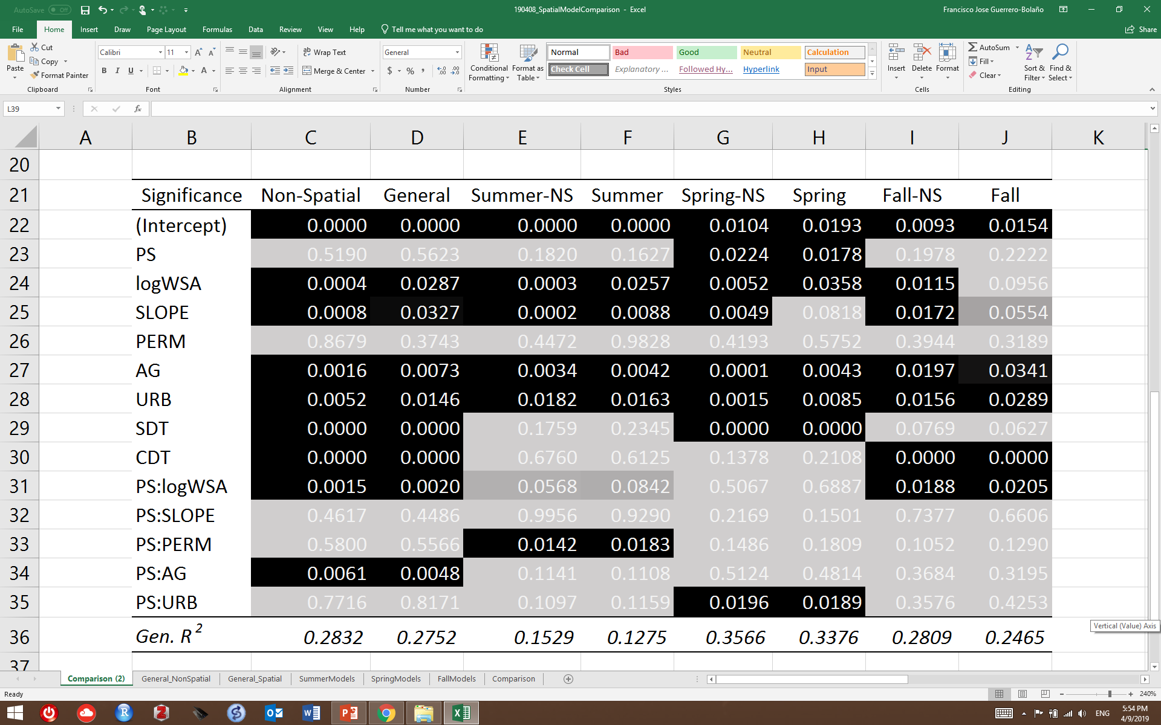
Results from seasonal models (Spatial-Non Spatial)
logTP ~ PS*(logWSA + SLOPE + PERM + AG + URB) + SDT + CDT
Spatial models include (Euclidean, Tail Up and Tail Down distances)
Coefficients
P-values

Slide 26
Results from seasonal models (Spatial-Non Spatial)
logTP ~ PS*(logWSA + SLOPE + PERM + AG + URB) + SDT + CDT
Spatial models include (Euclidean, Tail Up and Tail Down distances)
Coefficients | Non-Spatial | General | Summer-NS | Summer | Spring-NS | Spring | Fall-NS | Fall
(Intercept) | -3.519 | -3.634 | -2.826 | -3.115 | -2.087 | -2.441 | -2.122 | -2.130
PS | 0.073 | 0.065 | -0.221 | -0.231 | 0.493 | 0.503 | 0.401 | 0.382
Log[WSA] | 0.100 | 0.099 | 0.112 | 0.109 | 0.085 | 0.117 | 0.080 | 0.076
SLOPE | -0.412 | -0.306 | -0.506 | -0.401 | -0.375 | -0.283 | -0.332 | -0.287
PERM | 0.007 | -0.046 | 0.035 | 0.001 | 0.037 | -0.034 | -0.040 | -0.053
AG | 0.018 | 0.017 | 0.018 | 0.019 | 0.023 | 0.020 | 0.015 | 0.015
URB | 0.014 | 0.014 | 0.013 | 0.014 | 0.016 | 0.017 | 0.013 | 0.014
SDT | -0.238 | -0.240 | 0.205 | 0.180 | -1.546 | -1.438 | 1.053 | 1.107
CDT | -0.601 | -0.602 | -0.115 | -0.140 | 0.787 | 0.648 | -0.547 | -0.547
PS:logWSA | -0.023 | -0.022 | -0.023 | -0.021 | -0.008 | -0.005 | -0.033 | -0.033
PS:SLOPE | -0.024 | -0.024 | 0.000 | 0.004 | -0.076 | -0.088 | -0.028 | -0.037
PS:PERM | 0.007 | 0.007 | 0.049 | 0.047 | -0.030 | -0.027 | -0.047 | -0.045
PS:AG | 0.003 | 0.003 | 0.003 | 0.003 | -0.001 | -0.001 | 0.003 | 0.003
PS:URB | 0.000 | 0.000 | 0.003 | 0.003 | -0.004 | -0.004 | -0.003 | -0.002
Gen. R² | 0.2832 | 0.2752 | 0.1529 | 0.1275 | 0.3566 | 0.3376 | 0.2809 | 0.2465

Slide 27
Results from seasonal models
logTP ~ PS*(logWSA + SLOPE + PERM + AG + URB) + SDT + CDT
Spatial models include (Euclidean, Tail Up and Tail Down distances)
These results suggests that there is an underlying spatial structure in the residual variance beyond the Nugget effect. In the Non-spatial model, this remaining variability is attributed
the sampling location. Sampling location contributes with predictive power via repeated measurements. Once other autocorrelation structures are included in the model (e.g. Euclidean, TD, TU, etc.), the contribution of the sampling location decreases drastically (temporal consistency is replaced by spatial autocorrelation?). For predictive purposes, a non-spatial model can be easier to implement and run to make predictions at monitored locations. Since covariates are explicitly spatial, we should be able to make predictions at any location across the entire network for any day of year. The question is whether the predictions made by a non-spatial model with random intercepts would be better than those from a model that uses spatial covariance structures. To predict at an unmeasured locations, or to better understand the role of spatial processes in modulating water quality, spatial models could offer better insights. However, the SSN structure does not allow for the incorporation of random slopes for the locations, which decreases the overall performance of the model.

Slide 28
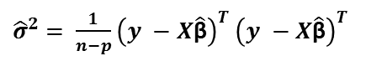
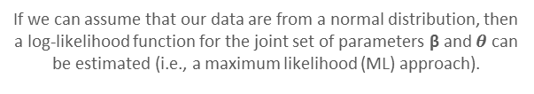
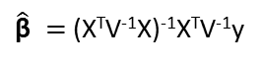
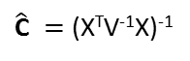
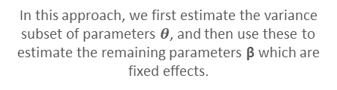
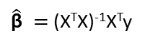
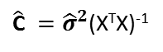
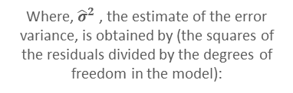
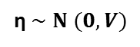
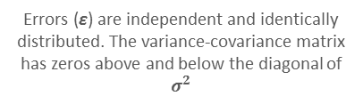
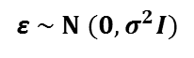
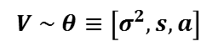
Model-based analysis using REML for inference from systematically sampled points
Systematic sampling (i.e., repeated measures or sampling across spatial grids), by definition, does not give rise to independent observations. The standard ordinary least squares (OLS) method for estimating the parameters of the general linear model is a design-based method that requires that the data have been collected according to an appropriate randomized sample design. For data collected in a systematic way, parameters of the general linear model can be estimated by model-based methods.
Model-based analysis assumes that the response variable is a realization of a random process. For model-based inference we must postulate an underlying model (including assumptions such as stationarity) on the basis of knowledge and experience, and evidence from the data. In this framework, sample units are not treated as independent. Instead, the correlation structure (either spatial or temporal) is characterized by the model. When we make estimates and inferences from observations in model-based analysis we do so on the basis of the model that describes the correlation or-more specifically-covariance structure.
Design-based analysis
Model-based analysis
Errors (ε) are independent and identically distributed. The variance-covariance matrix has zeros above and below the diagonal of $σ^{2}$
y is an n*1 vector of observed values for the variable y, X is an n*p “design matrix” of p explanatory variables,β is a p*1 vector of model coefficients.
η represents a random variate whose elements are not independent and with a relationship described by a variance-covariance matrix V.
y = Xβ + ε
y = Xβ + η
ε $\sim Ν (0,σ^{2}I)$
η $\sim Ν (0,V)$
When a variance-covariance matrix V has been estimated then we may estimate β by inserting the estimate into the generalized least squares equations:
Under the assumption that the variables in ε are random and iid, an ordinary least squares estimate of β is:
$\hat{\text{β}} =$ (X^{T}X)⁻¹X^{T}y
$\hat{\text{β}} =$ (X^{T}V⁻¹X)⁻¹X^{T}V⁻¹y
Where, ${\hat{σ}}^{2}$ , the estimate of the error variance, is obtained by (the squares of the residuals divided by the degrees of freedom in the model):
$\hat{\text{C}} ={\hat{σ}}^{2}$(X^{T}X)⁻¹
$\hat{\text{C}} =$ (X^{T}V⁻¹X)⁻¹
In this approach, we first estimate the variance subset of parameters $θ$, and then use these to estimate the remaining parameters β which are fixed effects.
Covariance matrix
${\hat{σ}}^{2}$ $= \frac{1}{n−p}{\left(y −X\hat{\text{β}}\right)}^{T}$ ${\left(y −X\hat{\text{β}}\right)}^{T}$
$$V \sim θ≡\left[σ^{2}, s, a\right]$$
If the error variables are from a normally distributed process then the OLS estimates of the model coefficients is equivalent to the maximum likelihood (ML) estimate.
If we can assume that our data are from a normal distribution, then a log-likelihood function for the joint set of parameters β and $θ$ can be estimated (i.e., a maximum likelihood (ML) approach).

Slide 29
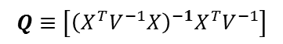
Limitations of the ML approach in model-based analysis and REML
The maximum likelihood (ML) estimation of the set of parameters β and $θ$ is calculated from the function:
$l\left(βθ|y\right)=constant− \frac{1}{2}\log\left|V\right|−\frac{1}{2} {(y −Xβ)}^{T}$ $V^{−1}(y −Xβ)$
However, the ML estimates of the variance parameters $θ$ is subject to bias because of their dependence on $β$. Typically, ML underestimates random-effect standard deviations. To avoid this bias such dependence needs to be removed. To do so, it is necessary to define a new likelihood function in which the variance parameters $θ$ are variables, but the likelihood is conditional on the parameters in $β$. The parameters in $θ$ are then estimated by maximization of this likelihood.
$l\left(θ|β,\hat{β}\right)=constant− \frac{1}{2}\log\left|V\right|−\frac{1}{2}log⁡|{X^{T}V^{−1}X|}−\frac{1}{2}$ $y^{T}V^{−1}\left(I−Q\right)y$
Residual Maximum Likelihood function (REML)
$$Q≡\left[{\left(X^{T}V^{−1}X\right)}^{−1}X^{T}V^{−1}\right]$$
Having found the parameters $θ$ that maximize the conditional log-likelihood, we might use the estimated covariance matrix V to obtain the REML estimates of the parameters $β$ and their covariance matrix.

Slide 30
ML-Approach
REML-Approach
Contribution to variance
Contribution to variance

Slide 31
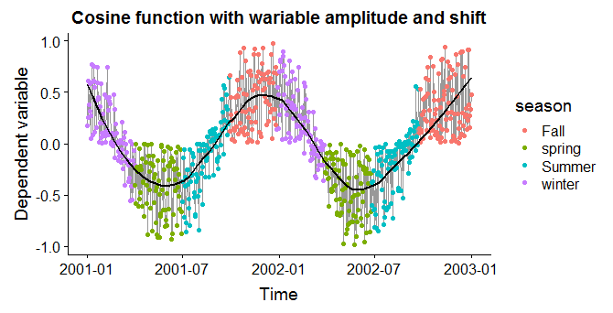
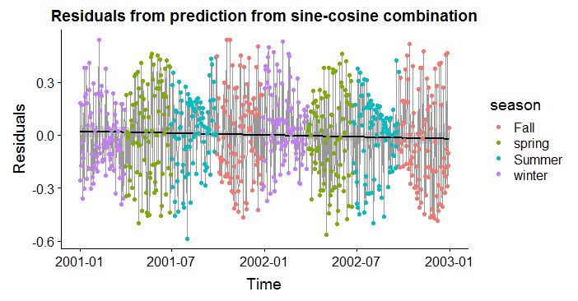
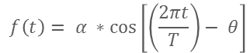
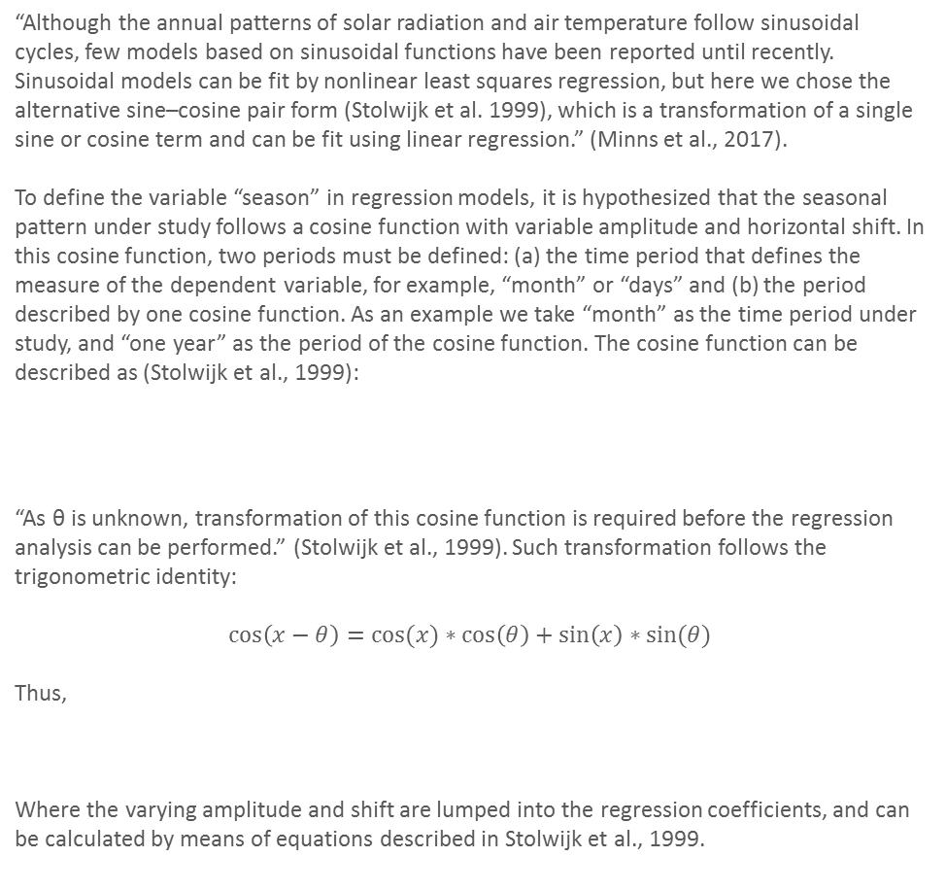
Seasonality analysis
“Although the annual patterns of solar radiation and air temperature follow sinusoidal cycles, few models based on sinusoidal functions have been reported until recently. Sinusoidal models can be fit by nonlinear least squares regression, but here we chose the alternative sine–cosine pair form (Stolwijk et al. 1999), which is a transformation of a single sine or cosine term and can be fit using linear regression.” (Minns et al., 2017).
To define the variable “season” in regression models, it is hypothesized that the seasonal pattern under study follows a cosine function with variable amplitude and horizontal shift. In this cosine function, two periods must be defined: (a) the time period that defines the measure of the dependent variable, for example, “month” or “days” and (b) the period described by one cosine function. As an example we take “month” as the time period under study, and “one year” as the period of the cosine function. The cosine function can be described as (Stolwijk et al., 1999):
“As θ is unknown, transformation of this cosine function is required before the regression analysis can be performed.” (Stolwijk et al., 1999). Such transformation follows the trigonometric identity:
$$\cos\left(x−θ\right)=cos⁡(x)∗\cos\left(θ\right)+\sin\left(x\right)∗sin⁡(θ)$$
Thus,
Where the varying amplitude and shift are lumped into the regression coefficients, and can be calculated by means of equations described in Stolwijk et al., 1999.
$$f\left(t\right)= α ∗\cos\left[\left(\frac{2πt}{T}\right)− θ\right]$$
$f\left(t\right)= α ∗\cos\left[\left(\frac{2πt}{T}\right)− θ\right]= β_{1 }$* $\cos\left[\left(\frac{2πt}{T}\right)\right]+β_{2 }\text{∗ }\sin\left[\left(\frac{2πt}{T}\right)\right]$

Slide 32
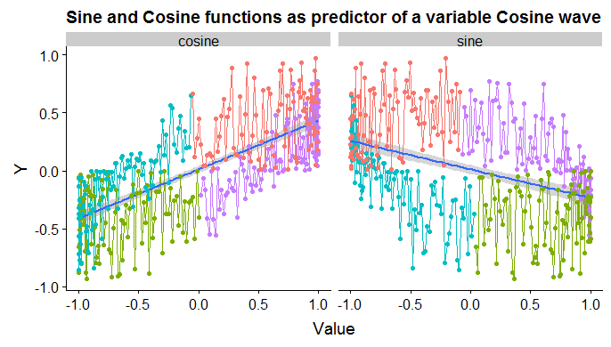
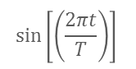
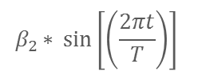
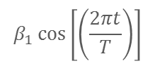
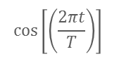
Modeling circular time with linear predictors
Describing seasonality in a linear model by a combination of sine and cosine functions assumes circularity in time. More precisely, the seasonal variation is described by an ellipse that can be parameterized by means of its two mayor axes. The sinusoidal term parameterizes the short axis, and the cosine term parameterizes the long axis.
Autumnal
Equinox
Summer
Solstice
Summer
Fall
Winter
Solstice
Spring
Winter
$$β_{1 }cos\left[\left(\frac{2πt}{T}\right)\right]$$
Vernal
Equinox
$$β_{2}{\text{∗ }\sin\left[\left(\frac{2πt}{T}\right)\right] }$$
$$\cos\left[\left(\frac{2πt}{T}\right)\right]$$
$$\sin\left[\left(\frac{2πt}{T}\right)\right]$$
In linear terms, the gradient in conditions between solstices is larger than the gradient in conditions between equinoxes. Thus, another way to interpret this representation of circular time in terms by a linear combination of sine and cosine functions is that the cosine term represents the inter-solstitial variability and that the sine term represents the inter-equinoctial variability.

Slide 34
ML-Approach
REML-Approach
Contribution to variance

Slide 35
ML-Approach
REML-Approach
Contribution to variance
Contribution to variance

Slide 39

A Moving Average Approach for Signal Propagation
along Stream Networks
This approach is inspired in time series models.
Although AR models are more popular, MA models
have interesting properties.
In an attempt to create multivariate spatial models
and filter white noise across space, JVH developed the
mathematical framework, but it was EP who came with
the idea of applying these models to stream networks.
When the moving average approach is extended to the
continuous domain, the distances between observations
approach zero (i.e. the MA becomes a white noise
process) and an integral is required to average these values
(instead of a sum), which gives you the solution as a
continuous random function.
Under weak stationarity assumptions the autocorrelation
and the semi-variograms are related and can be predicted from
different autocorrelation models (e.g. Tail Up, Tail Down).
Tail Up models (shown in the figure) produce contrasting
autocorrelation structures to those produced by Tail Down
Models. Furthermore, TU models require an additive
function which determines how much of the area under the
curve is assigned to each branch in the network as the join at
a confluence.
Signal propagation
along the stream
Moving average function
splits at confluences
Moving Average
Functions
Random signal
(e.g. Brownian Motion)
Flow
Modified from Ver Hoef, 2019

Slide 40
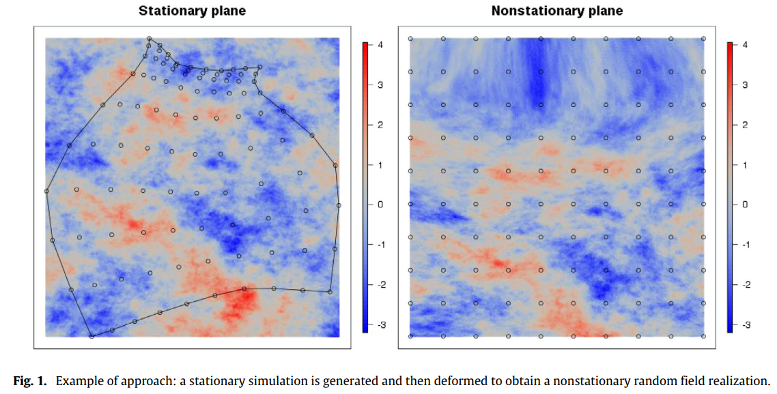

Slide 41
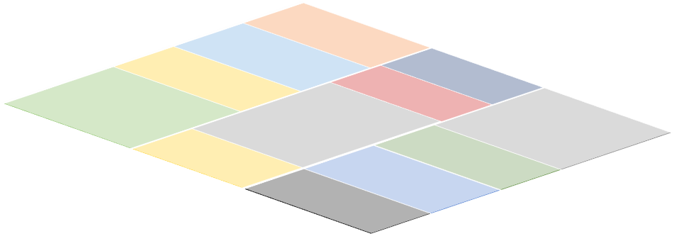
White noise
(random process)
Flow
Moving Average
splits at confluences
Moving Average
Functions
Flow
Signal propagation
along the stream network
Flow
Accounting for the role of
land use and
other covariates
Modified from Ver Hoef (2019)

